Slide 1
Fandango Movie Rating Discrepancy Analysis using Python
CAPSTONE PROJECT
Presented By:
GEORGE STEPEN RAJ A
3rd year ELECTRICAL AND ELECTRONICS ENGINEERING
SREE SOWDAMBIKA COLLEGE OF ENGINEERING

Slide 2
OUTLINE
Problem Statement
Proposed System/Solution
System Development Approach
Algorithm & Deployment
Result
Conclusion
Future Scope
References

Slide 3
Problem Statement
To explore rating differences between Fandango and other platforms like IMDb or Rotten Tomatoes, we'll gather movie ratings data, clean it to remove inconsistencies, and then analyze it using Python. By comparing average ratings, visualizing rating distributions, and examining potential factors such as movie genres or release years, we aim to uncover any biases or inconsistencies in Fandango's rating system. Ultimately, this analysis will help us understand why rating variations occur and shed light on the reliability of Fandango's ratings compared to more objective sources like IMDb or Rotten Tomatoes.

Slide 4
Proposed Solution
Data Collection:
Obtain movie ratings data from Fandango and another reliable source (e.g., IMDb).
Data Cleaning:
Clean the data to ensure accuracy and consistency.
Data Analysis:
Calculate summary statistics (mean, median, standard deviation, etc.) for both Fandango and the other source.
Visualize the distribution of ratings from both sources using histograms or boxplots.
Perform hypothesis testing to determine if there's a significant difference between the ratings.

Slide 5
System Approach
Problem Definition:
Clearly define the objective of the analysis, such as understanding the extent of rating inflation on Fandango compared to other platforms.
Scope Definition:
Determine the scope of the analysis, including which movies, time period, and comparison platforms will be included.
Data Collection:
Gather Fandango ratings data using web scraping or an API.
Collect ratings data from alternative sources like IMDb or Rotten Tomatoes.
Ensure data integrity and completeness.
Data Preprocessing:
Clean the data by handling missing values, inconsistencies, and outliers.
Normalize ratings to a common scale if necessary.
Explore the data to understand its distribution and characteristics.

Slide 6
Algorithm & Deployment
Algorithm Development:
Data Collection:
Utilize web scraping or APIs to gather Fandango movie ratings data and ratings from alternative sources such as IMDb or Rotten Tomatoes.
Data Preprocessing:
Clean the collected data, handle missing values, and normalize ratings if needed.
Analysis:
Calculate summary statistics, visualize rating distributions, and conduct hypothesis testing to identify discrepancies between Fandango ratings and ratings from other sources.
Insights Generation:
Interpret the analysis results to understand the reasons behind rating differences and provide actionable insights.

Slide 7
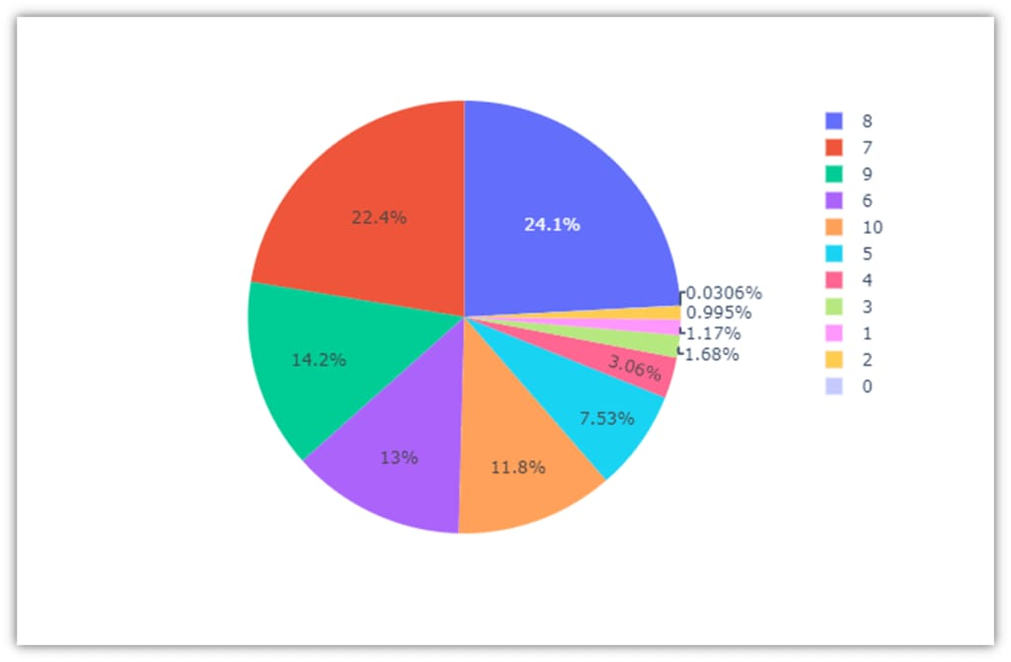
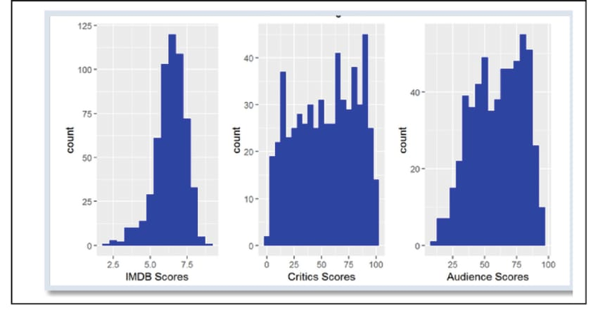
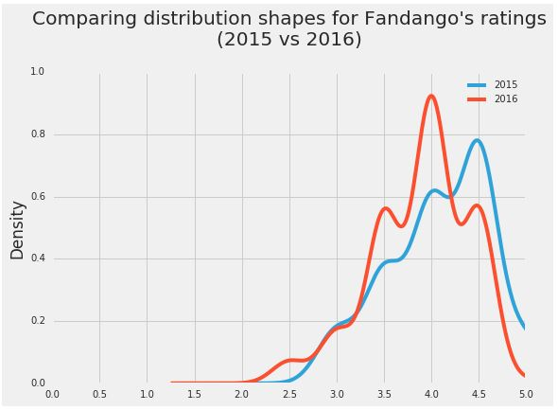
Result

Slide 8
Conclusion
Our analysis found that there's a small difference between how Fandango rated popular movies in 2015 compared to those in 2016. On average, movies released in 2016 got slightly lower ratings on Fandango than those released in 2015. This suggests that there might have been some changes in Fandango's rating system or how they selected and rated movies over the years.

Slide 9
Future scope
Using Python for analysing Fandango movie rating differences has promising future potential. It could involve building predictive models, creating visualization tools, developing automated monitoring systems, exploring sentiment analysis, and integrating with other databases for comparative analysis, enhancing accuracy and insights.

Slide 10
References
https://www.kaggle.com/datasets
https://pandas.pydata.org/pandas-docs/stable/user guide/index.html
https://seaborn.pydata.org/
https://matplotlib.org/stable/contents.html
https://chat.openal.com

Slide 11
THANK YOU

